Slide 1
HUMAN RESOURCES
MINI PROJECT
DATA PRE-PROCESSING
EXPLORATORY DATA ANALYSIS
PYTHON FOR DATA SCIENCE
UTSAV KALRA - 21070126105
VAISHNAVI PATIL - 21070126108

Slide 2

AIM
Its sole aim is to provide better insight into each of the human resource processes, gathering related data and then using this data to make informed decisions on how to improve these processes.

Slide 3
WHY HUMAN RESOURCES
Managing and using people effectivelyTying performance appraisal and compensation to competenciesDeveloping competencies that enhance individual and organizational performanceIncreasing the innovation, creativity, and flexibility necessary to enhance competitivenessApplying new approaches to work process design, succession planning, career development, and inter-organizational mobilityManaging the implementation and integration of technology through improved staffing, training, and communication with employees

Slide 4
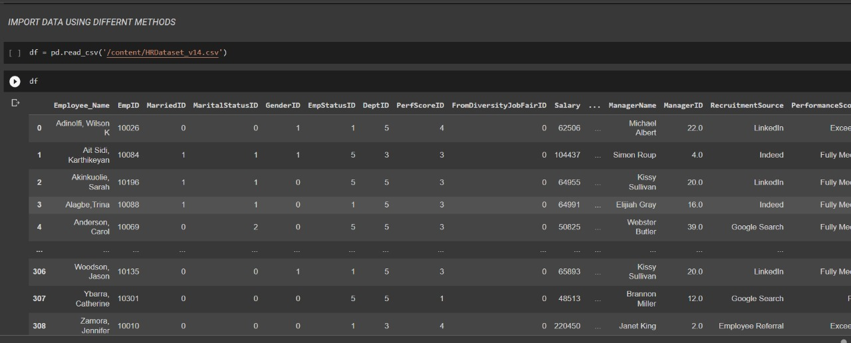
DATSET
We are working on expanding the data set even further by generating even more records and a few additional features. We will be keeping this as one file/one data set for now. There is a possibility of creating a second file perhaps down the road where you can join the files together to practice SQL/joins, etc. We have reduced the complexity of the dataset down to a single data file (v14). The CSV revolves around a fictitious company and the core data set contains names, DOBs, age, gender, marital status, date of hire, reasons for termination, department, whether they are active or terminated, position title, pay rate, manager name, and performance score.Recent additions to the data include:AbsencesMost Recent Performance Review DateEmployee Engagement Score

Slide 5
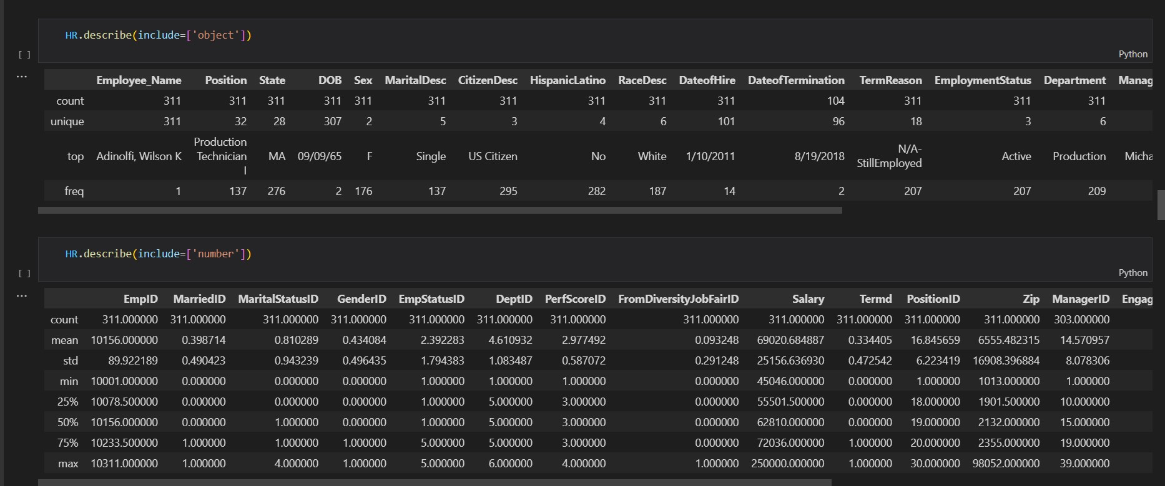
DESCRIBE OBJECTS AND NUMBERS IN DATA SET
This set is normally presented in a tabular pattern. Every column describes a particular variable.
The numerical data set is a data set, where the data are expressed in numbers rather than natural language. The numerical data is sometimes called quantitative data. The set of all the quantitative data/numerical data is called the numerical data set.

Slide 6

DATA CLEANING
TWO TYPES OF ENCODING CATEGORICAL TECHNIQUES
ONE HOT ENCODED
LABEL ENCODER
One-Hot Encoding is another popular technique for treating categorical variables. It simply creates additional features based on the number of unique values in the categorical feature. Every unique value in the category will be added as a feature.

Slide 7
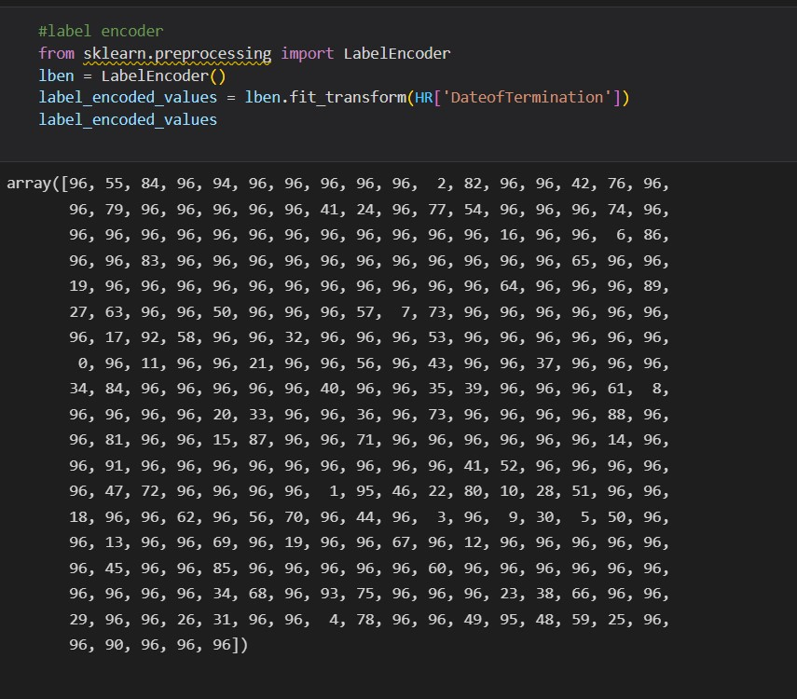
DATA CLEANING
LABEL ENCODING
Label Encoding is a popular encoding technique for handling categorical variables. In this technique, each label is assigned a unique integer based on alphabetical ordering

Slide 8
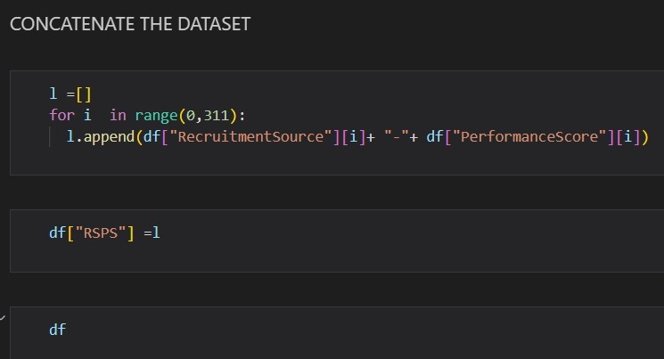
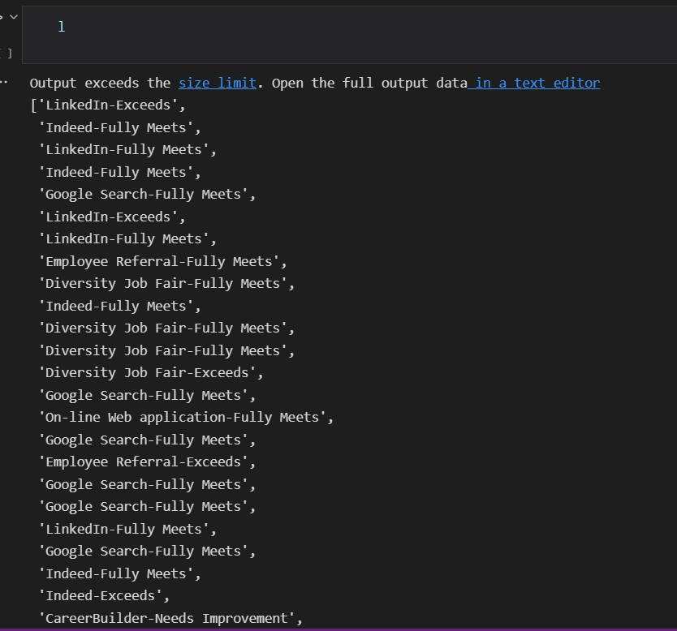
CONCATENATE THE DATASET
These operations can involve anything from very straightforward concatenation of two different datasets, to more complicated database-style joins and merges that correctly handle any overlaps between the datasets. Series and DataFrames are built with this type of operation in mind, and Pandas includes functions and methods that make this sort of data wrangling fast and straightforward.

Slide 9
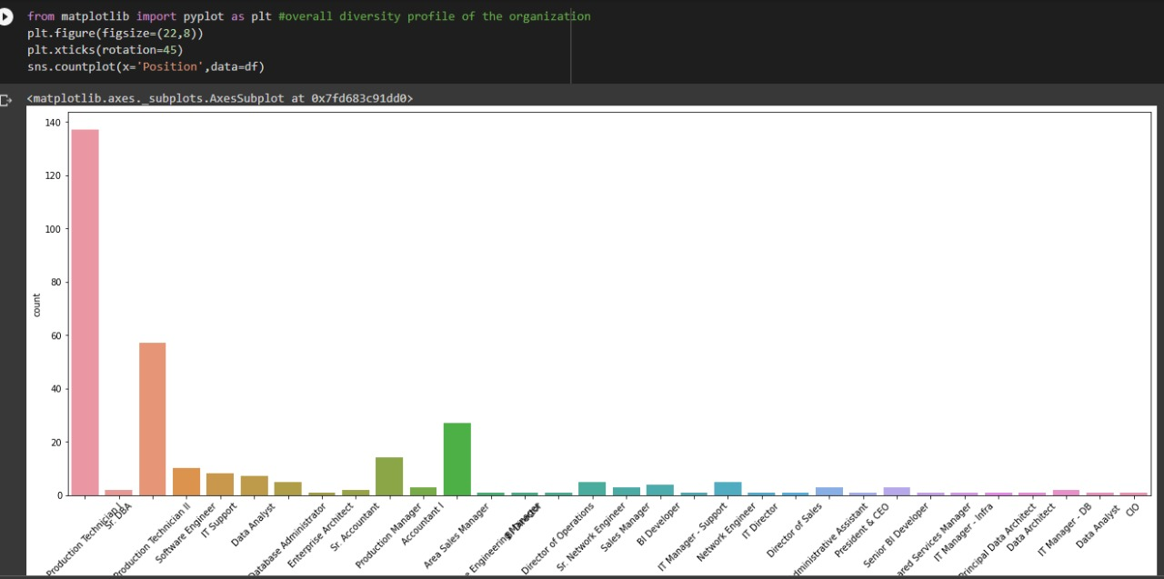
Overall diversity profile of the organisation : the graph shows the total amount of employees in every field of the company

Slide 10
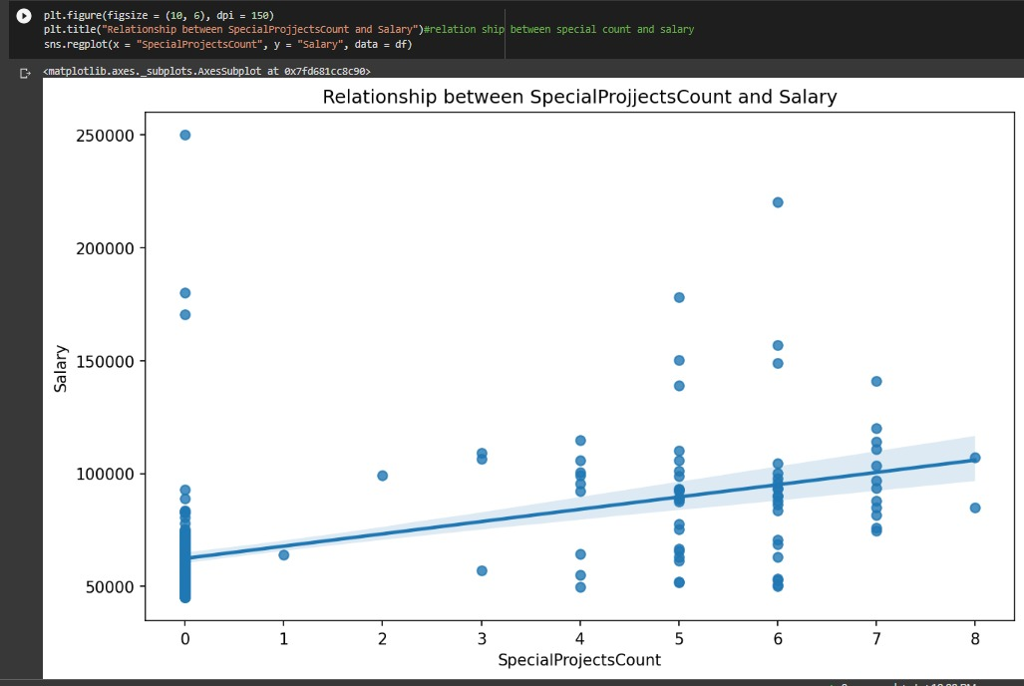
Relationship between special project count and salary : graph shows how does salary varies according to special projects made by employees

Slide 11
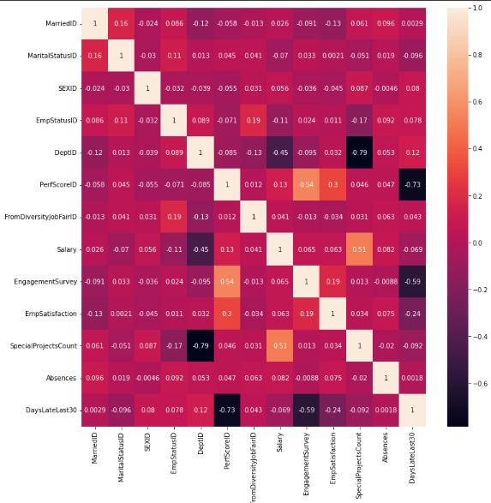
Heatmap : it is a graphical representation of data that uses a system of color-coding to represent different values

Slide 12
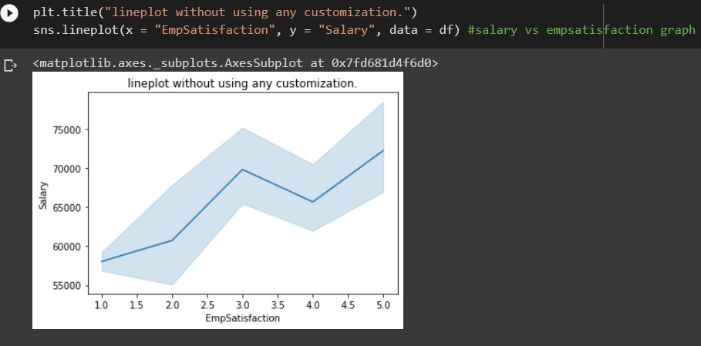
SALARY VS EMPLOMENT SATISFACTION : THE GRAPH SHOWS HOE DOES EMPLOMENT SATISFACTION VARIES ACCORDING TO THE SALARY OF THE EMPLOYEE

Slide 13
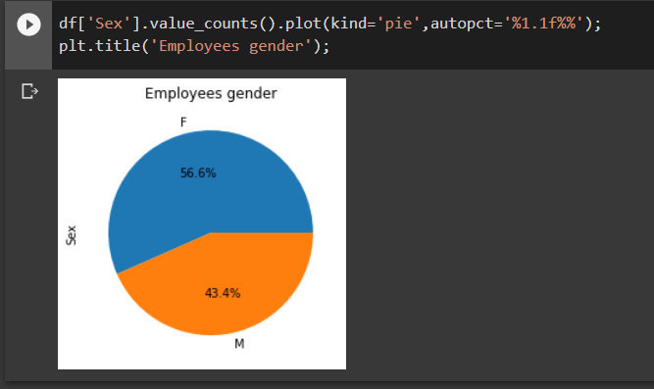
This pie chart shows total percentage of male and female in the company

Slide 14
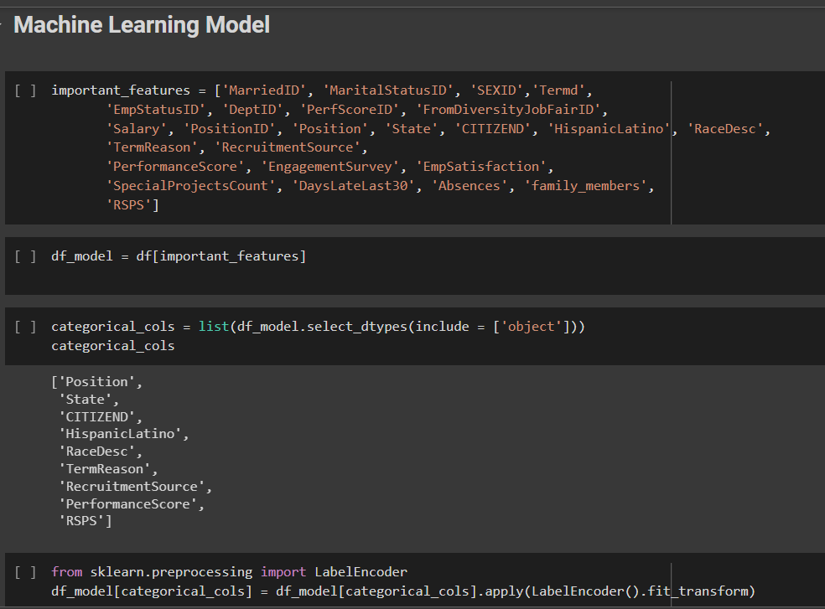
Machine Learning Model
In this model we are predicting that weather the employee will be terminated in future or will remain in the company.
By taking in order every perspective of the dataset, graphs, encoding….

Slide 15
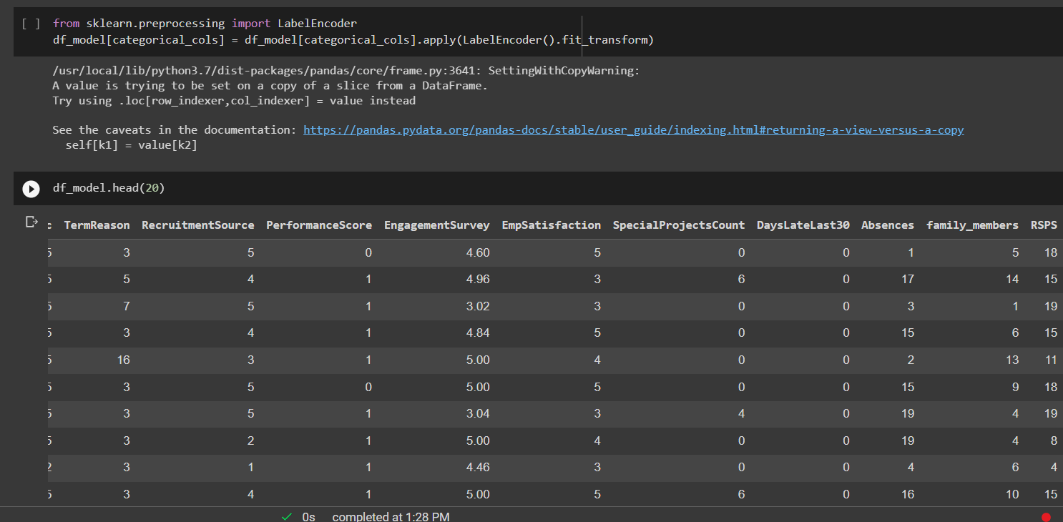
LABEL ENCODING IS DONE TO CONVER CATGORICAL DATA INTO UNIQUE INTEGERS

Slide 16
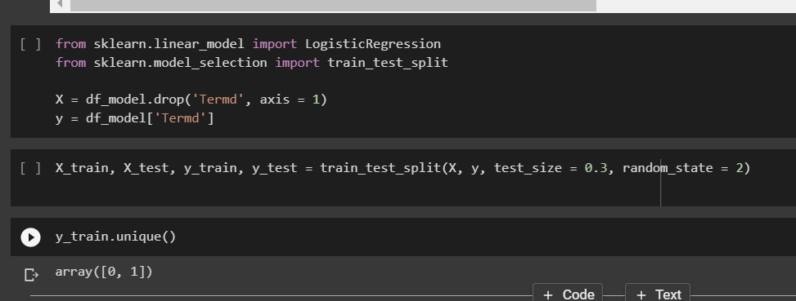
x=all columns except target column
y=target columns
x_train=70% data to train model data
y_train=70% target column data
x_test=rest 30% for testing after traning
y_test=30% target column for testing

Slide 17
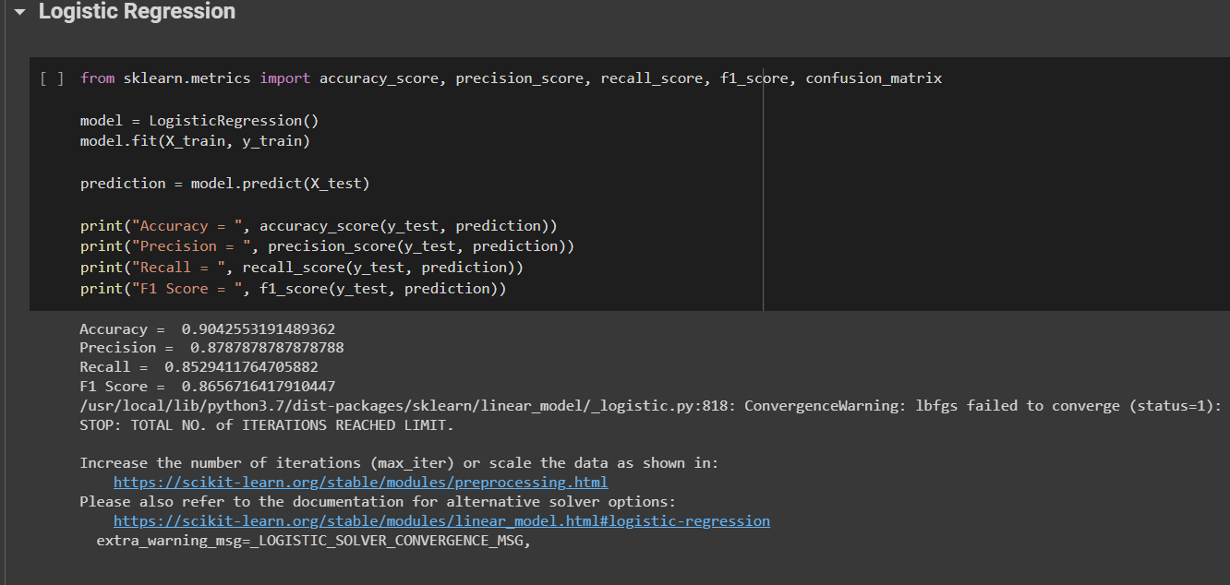
LOGISTIC REGRESSION

Slide 18
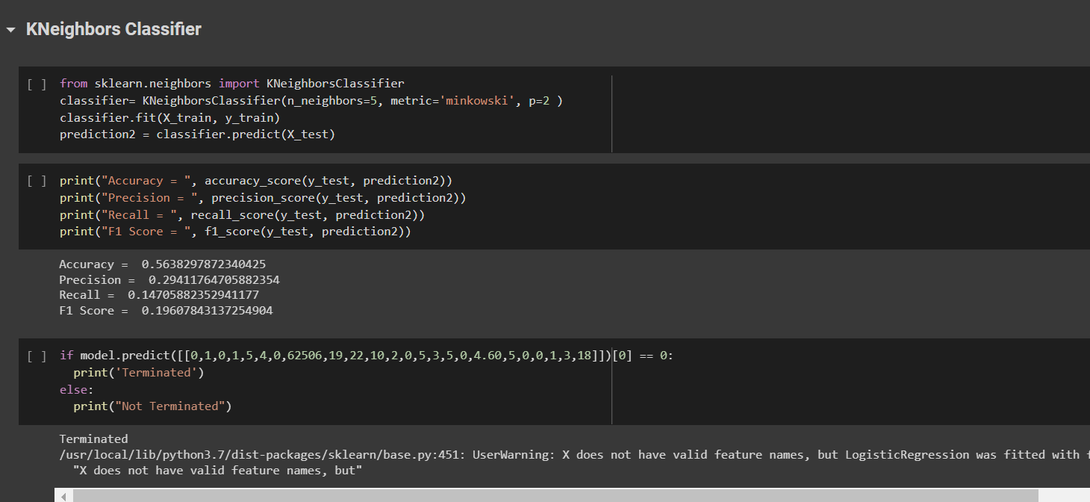
Kneighbors Classifier AlGORITHM

Slide 19
PROBLEEMS AND SOLUTIONS
Q) Competition (attracting and retaining good talent)
Competition is not only the most important factor in business and client interactions but also the most influential and threatening factor in HR. It is all the more difficult for small and medium enterprises since they need to compete with big names and brands while recruiting talent.
SOLUTION :
Furthermore, having a structured onboarding process helps combat initial hiccups in an employee’s experience in a new work environment, such as awkwardness to interact with strangers, not knowing whom to approach for issues, concerns, or questions, not knowing one’s key performance indicators for the job role, not knowing team members or the immediate manager well enough, etc.

Slide 20
Problem and solution
DIVERSITY While having a good ratio of diversity is a boon to an organization and is a good thing to boast of, from an HR perspective, organizations face challenges managing this diversity in age, gender, nationality, ethnicity, etc.
Solution - To resolve conflicts arising out of this diversity, it is important to sensitize all employees toward the cultures of different people they work with. Culture orientation as part of the onboarding process is a prime step in the correct direction.

Slide 21
Problem and solution
CONTINUOUS LEARNING AND SUCCESS PLANNING: Upskilling and continuous learning are extremely crucial to an employee’s growth and success in an organization. These days, with the increasing demands of the business, organizations are finding it difficult to foster an environment of continuous learning and development and keep pace with the rising ambitions of employees, for the paucity of time.
SOLUTION : The basic principle to effective training and development is to identify trainings relevant to the current or future role of an employee. Further, adopting a practical rather than theoretical approach to training helps. For example, presentations and PPTs are now old school

Slide 22
CONCLUSION
:In today world, the Human Resource Management plays a very significant role in the daily life. On the one hand, the Soft and Hard Human Resource Management influence on the business and lets them development rapidly. It can improve employee’s motivation in a business and pay attention to company’s policy and law respectively, which can increase the efficiency of company and get higher profits. On the other hand, trade unions help the employee to achieve negotiation successfully in the early time; it means the employee can negotiate a better wages and a good working condition .However, at the present, the employment law gradually becomes the focus in the world, because it has more restrictive and more favorable to protecting employee’s benefit. In the future, the Human Resources Management will continue to play its role in each business.

